Slide 1
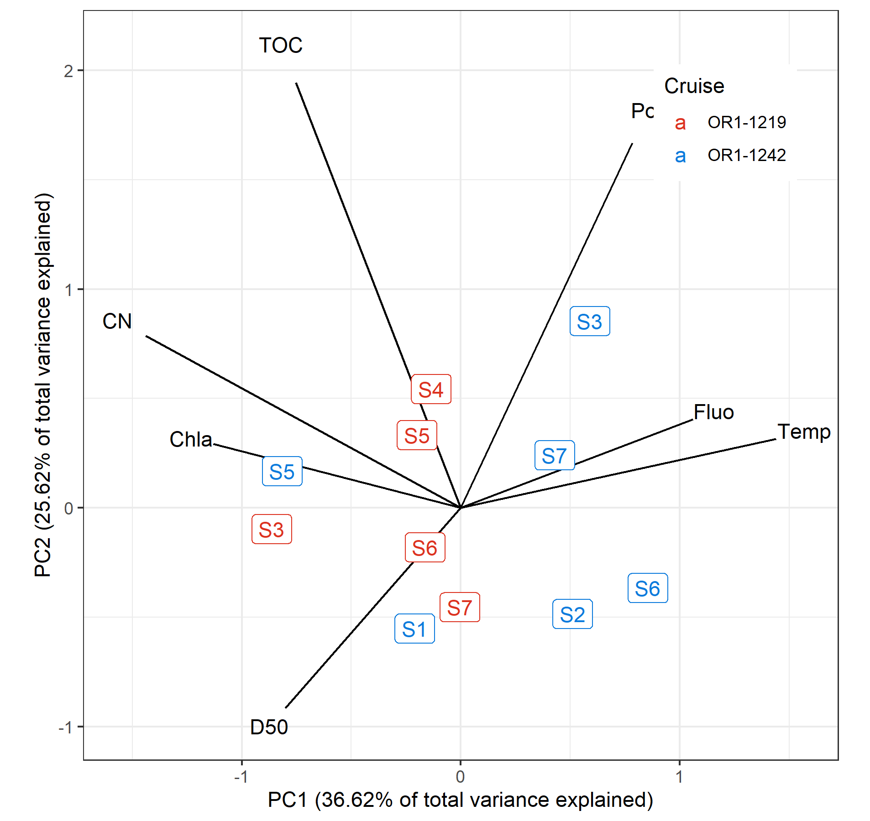
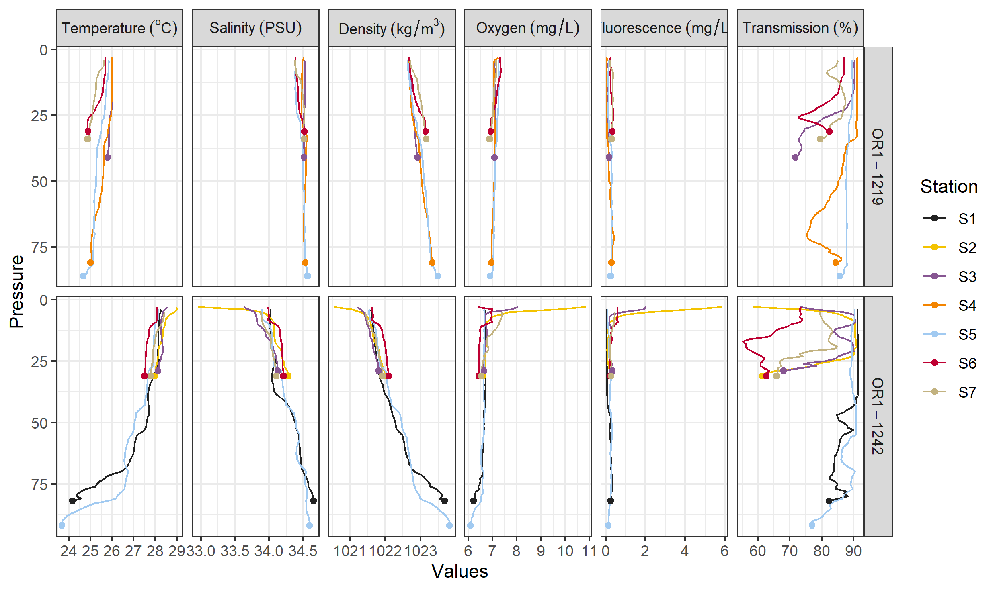
Environmental data
Depth and DRM were not included for this PCA and later analyses
Variables with |r| > 0.7 and/or ecologically irrelevant were omitted
Sal, Trans, Dens, Temp are highly correlated ➔ choosing Temp
Delta 13 C and Chla negatively correlated ➔ choosing Chla
TN correlated with Porosity ➔ choosing Por
Notes:
TN & porosity can be discussed

Slide 2
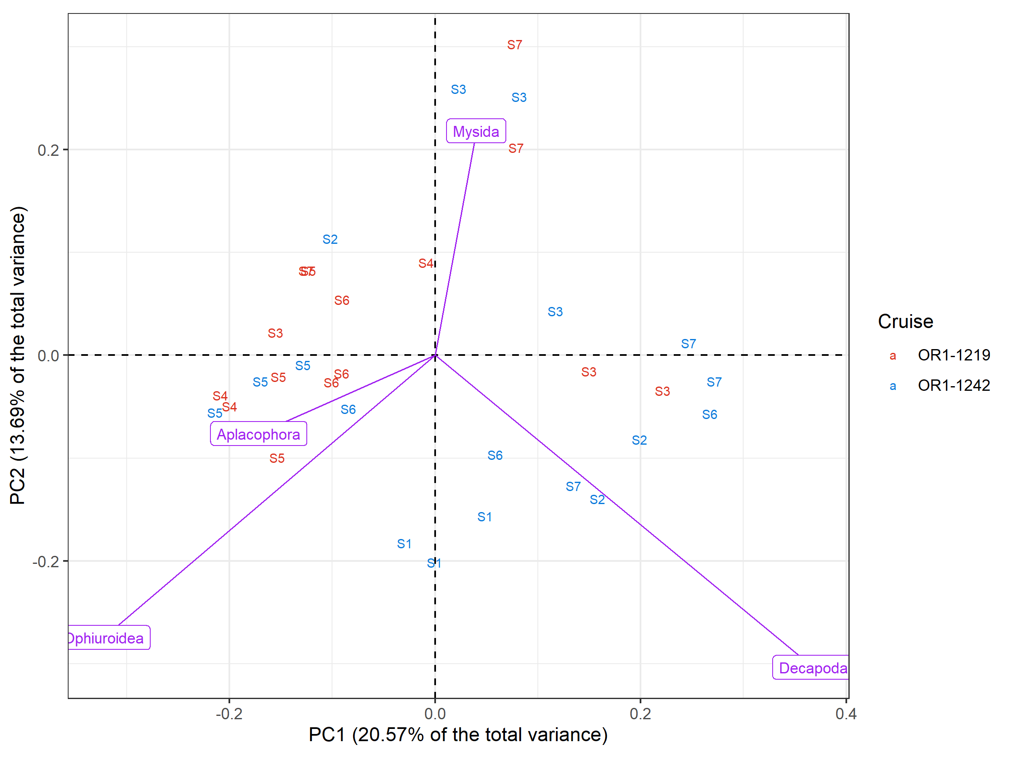
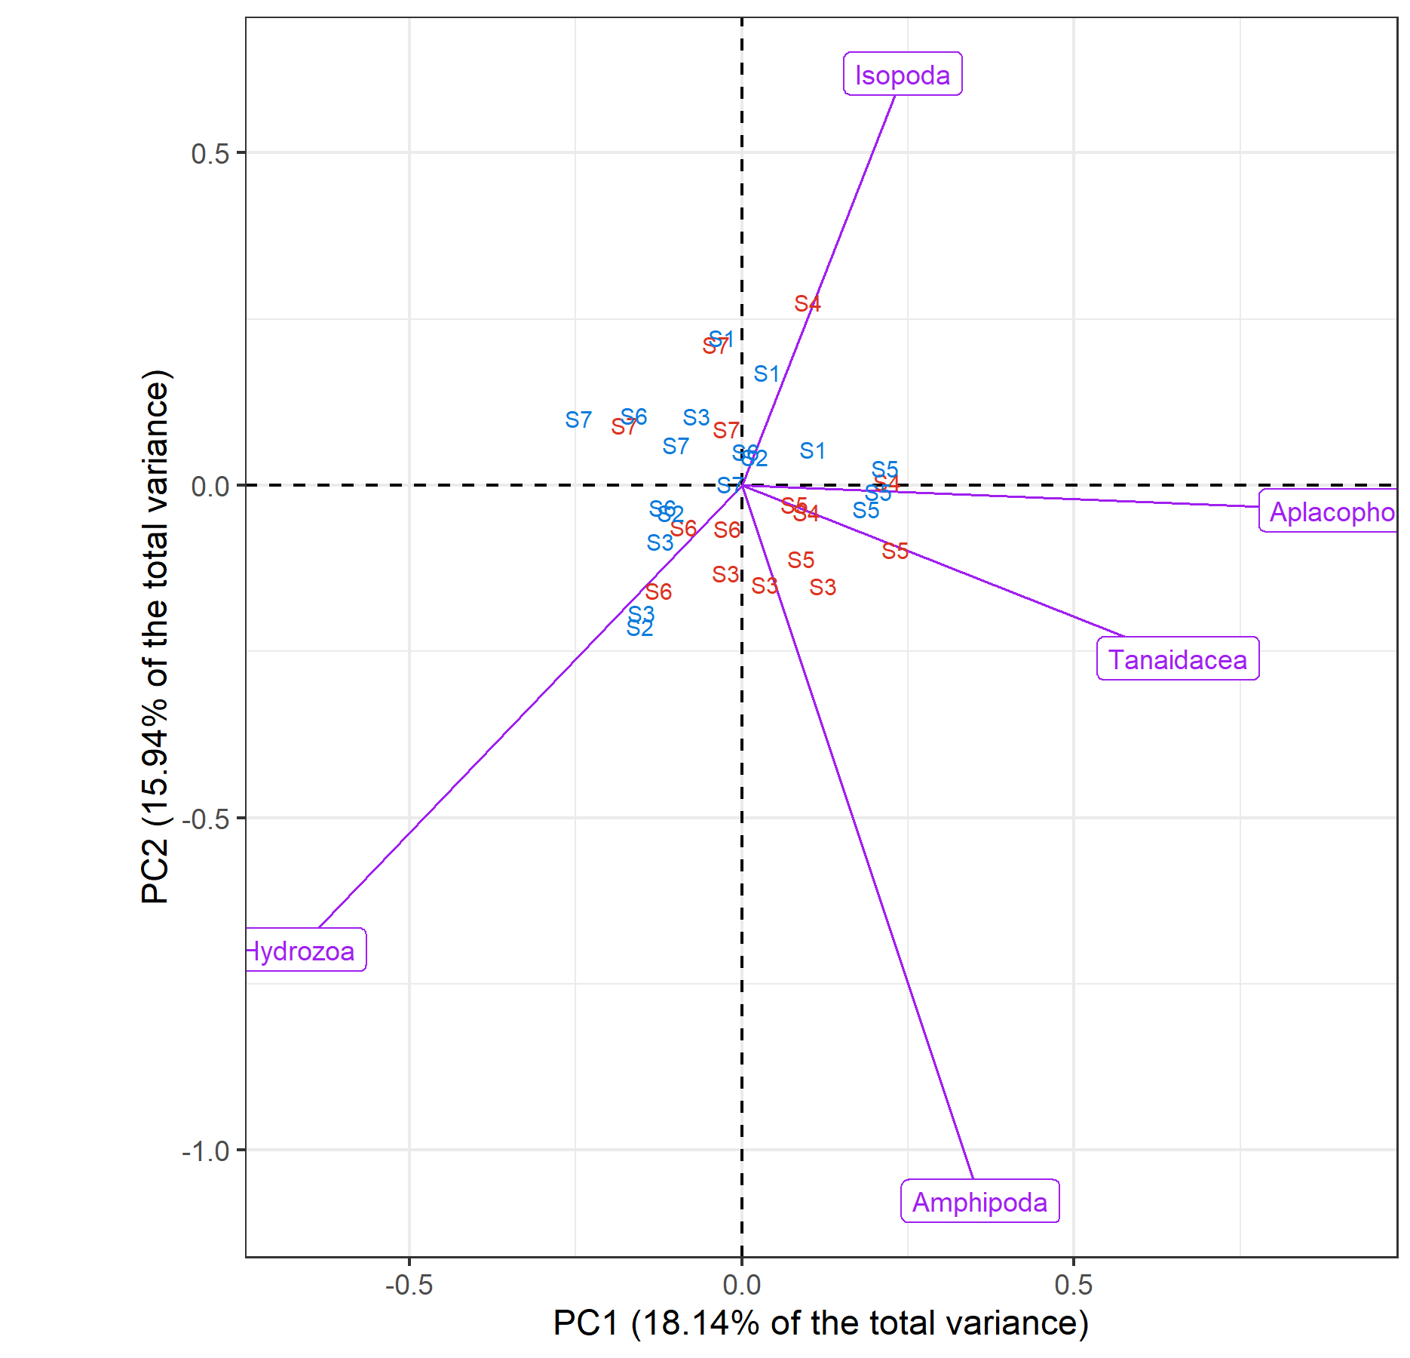
Box-Cox-chord transformed assemblage PCA, scaling 1 only taxa with >40% variance explained by the first two axes were shown
Count, exponent = 0.3
Biomass, exponent = 0.1
Notes:
Variation of peracarid abundance were largely captured within the first two PCs
Biomass composition mainly reflects the presence of large taxa; noticeable groupings were present (if these are non-stochastic)
Dominant species not included; Bray Curtis might yield different result
Rethink the ecological meaning; some interaction terms can be removed if no explanation can be sought.

Slide 3
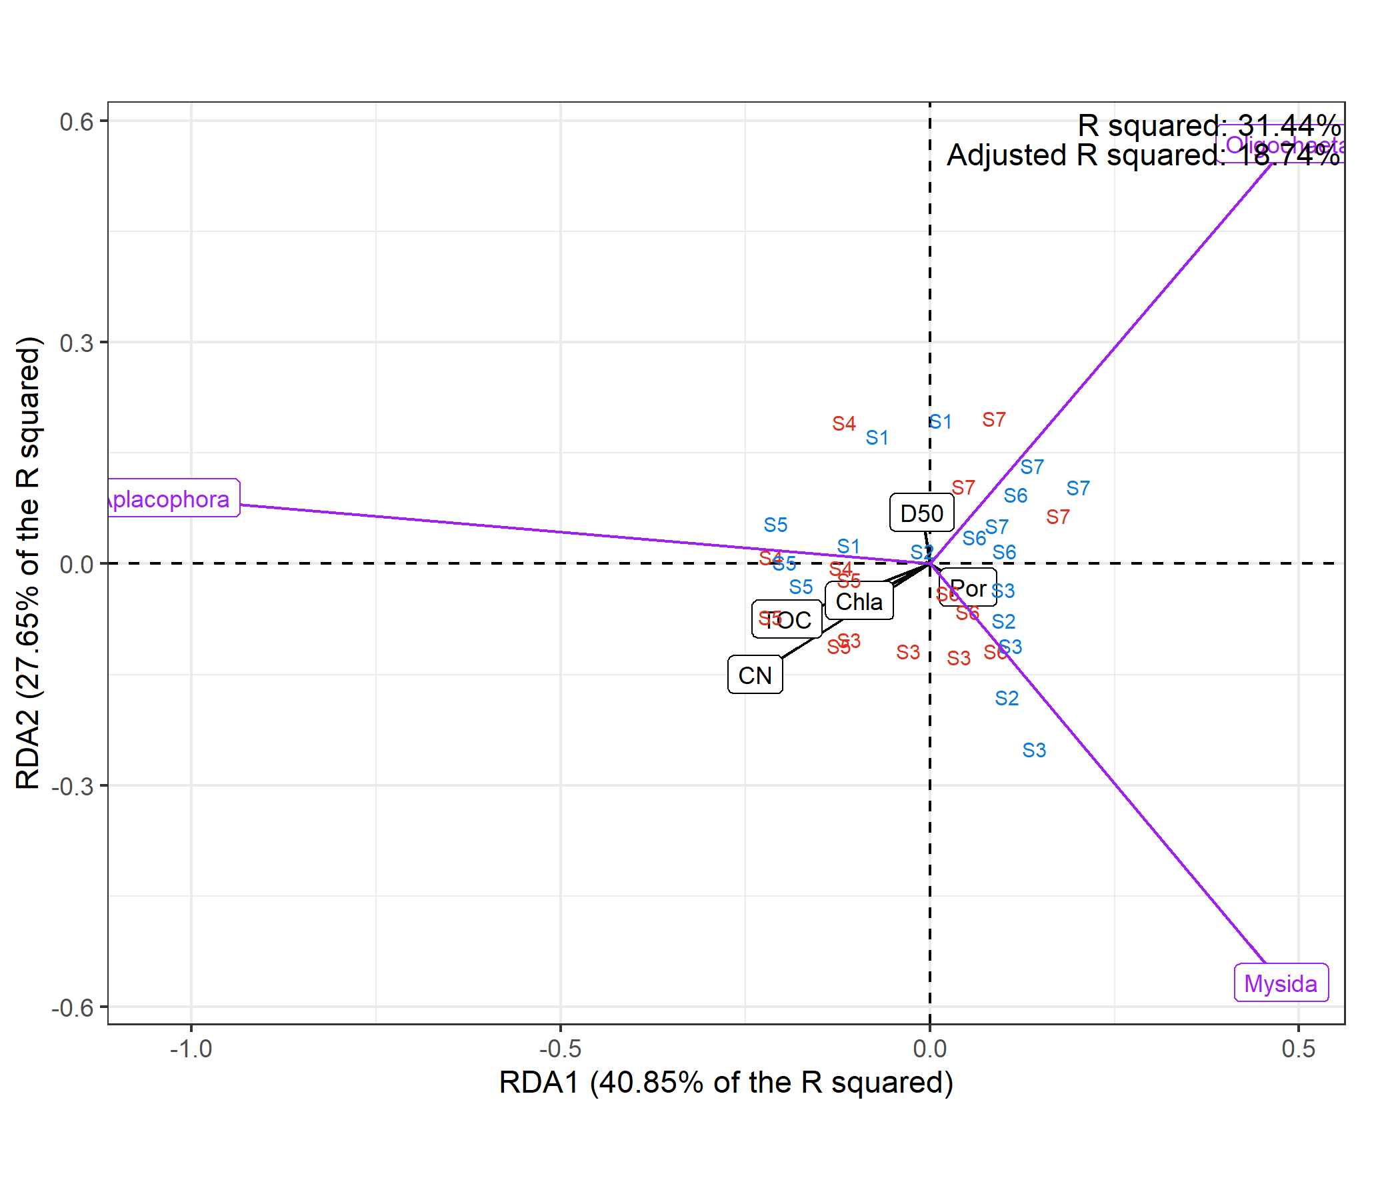
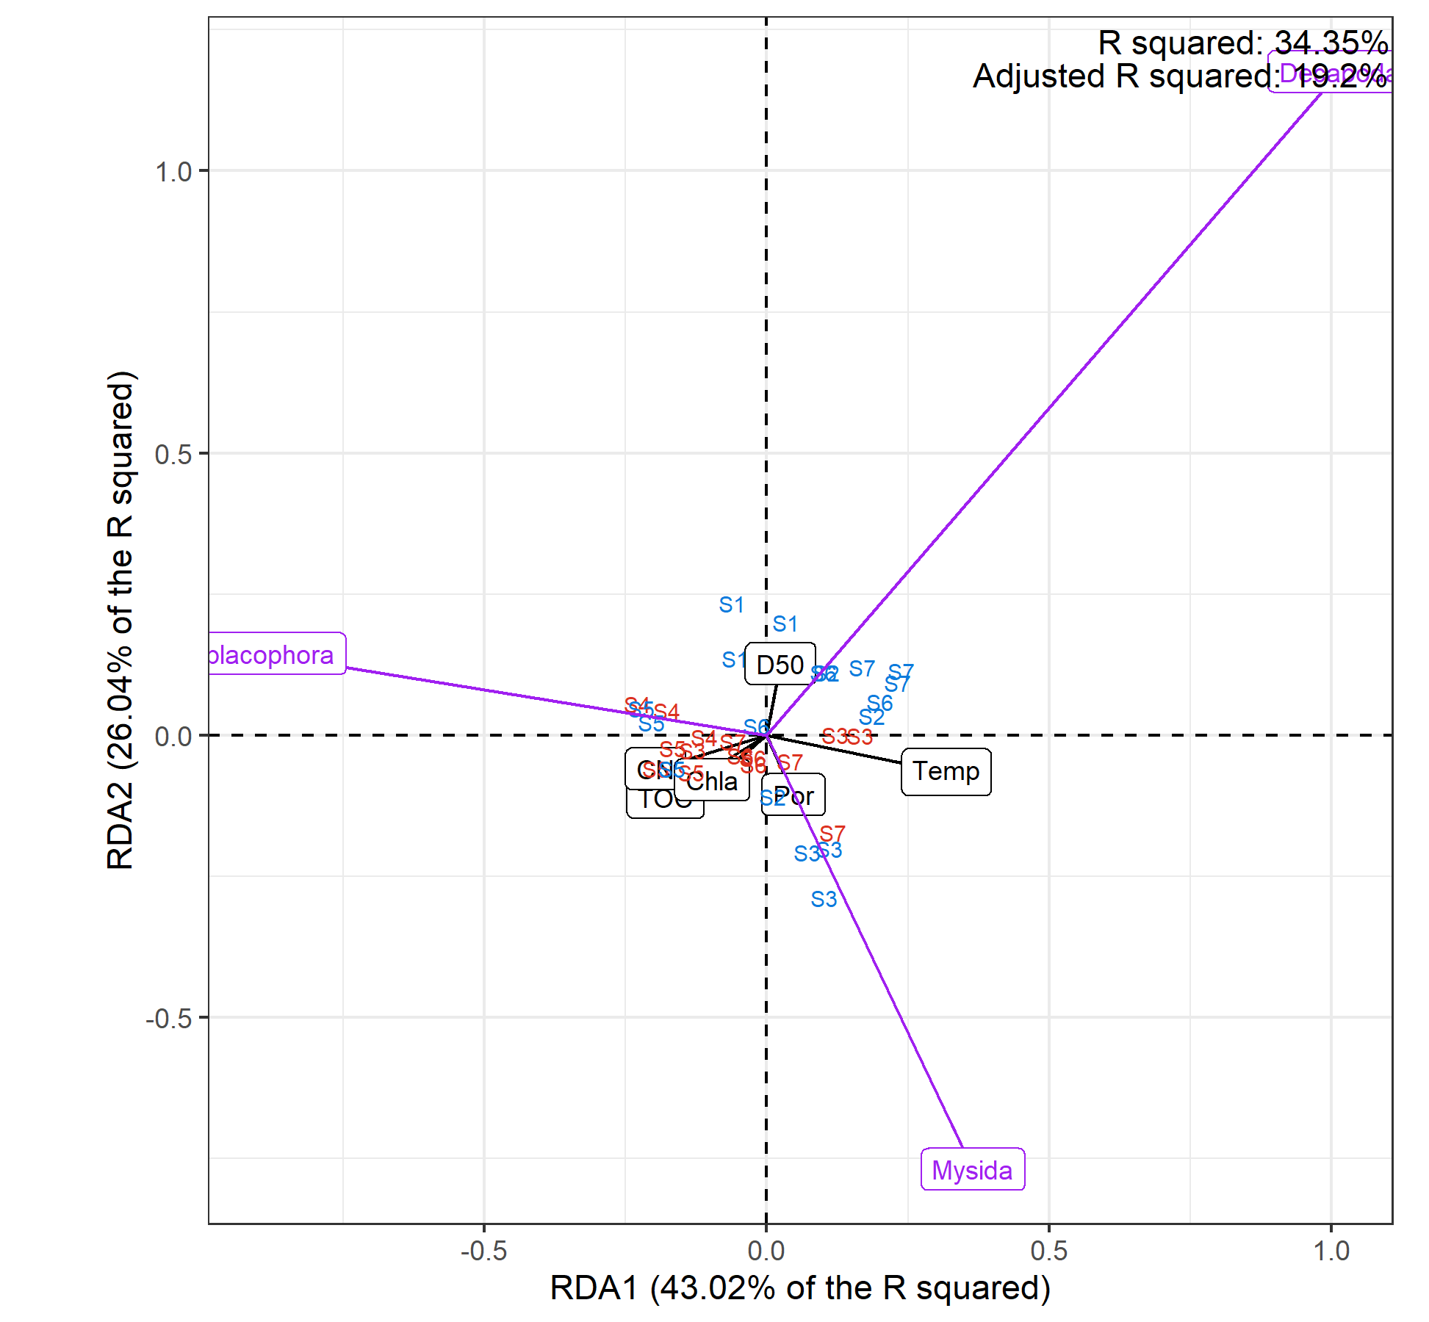
RDA triplot, scaling 1
Biomass, exponent = 0.1
Count, exponent = 0.3
Notes:
Forward selection picks out dominant environmental drivers by maximizing the adjusted R2 (ordiR2step) or
Backward selection removes variables that does not affect the model fit by statistically comparing the model fit before and after the removal.
Scale the species vectors
Write your discussion biomass
Try to plot something to describe the relationship between taxa and size

Slide 4
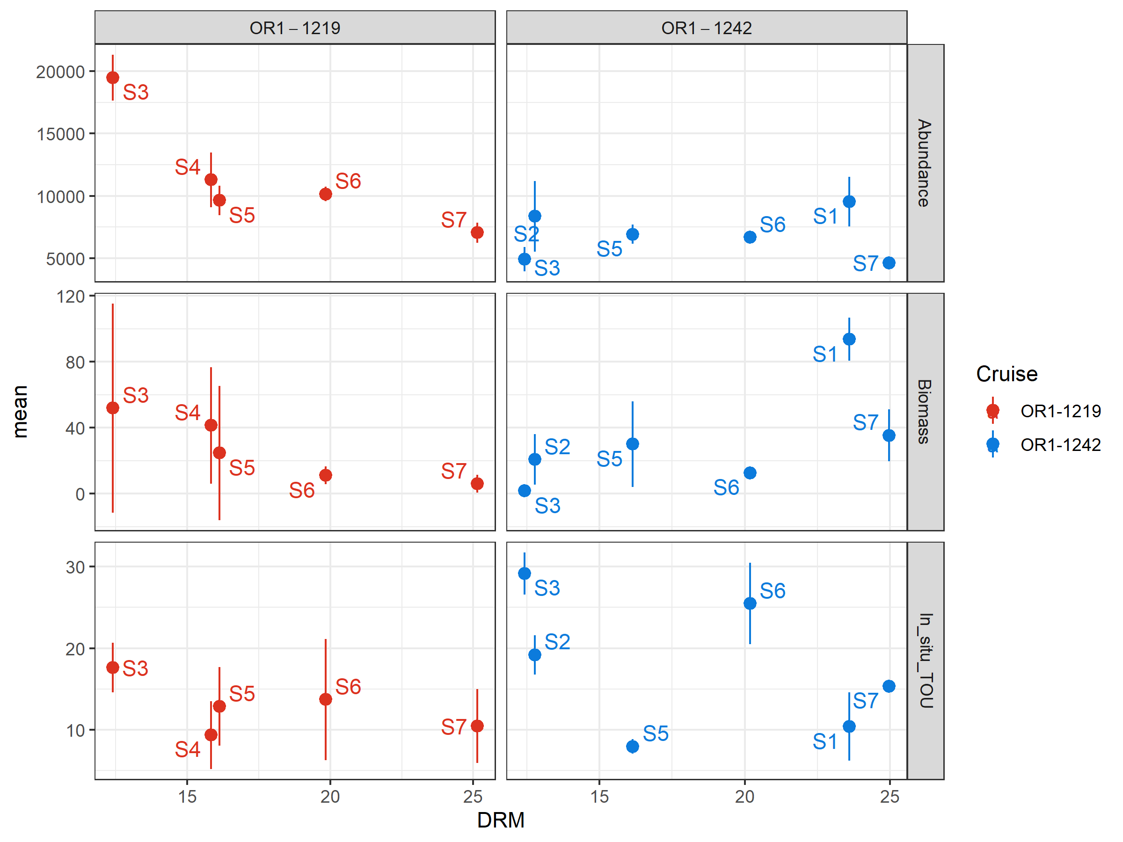
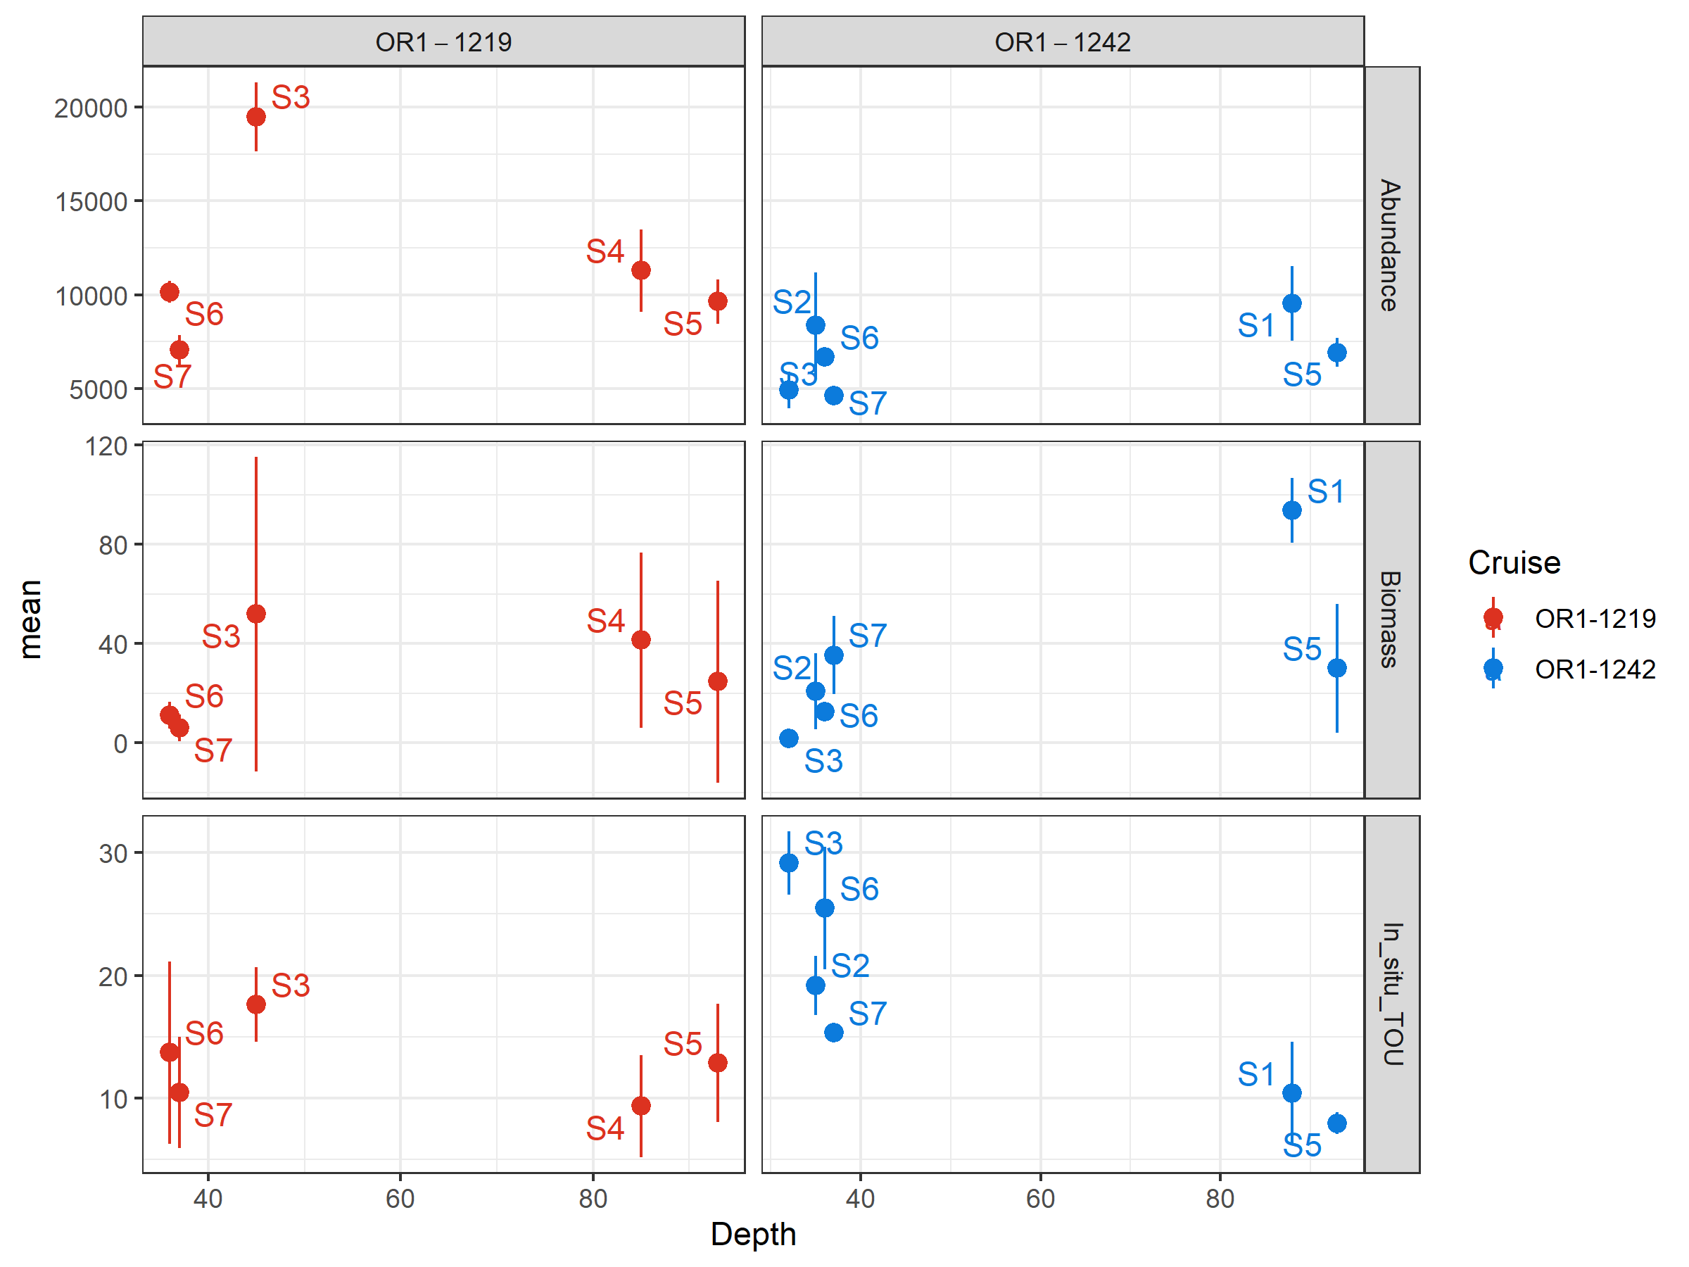
Abundance, biomass, and SCOC variation showed spatiotemporal variations
Multimodel framework were used for statistical inference
Nested models and models with delta > 6 were removed to obtain a top model set.
Natural averaging for detecting ecological responses.

Slide 5
Environmental drivers that shaped abundance, biomass, and SCOC
Abundance
Biomass
SCOC

Slide 6
Environmental drivers that shaped abundance, biomass, and SCOC
Abundance
Biomass
SCOC

Slide 7
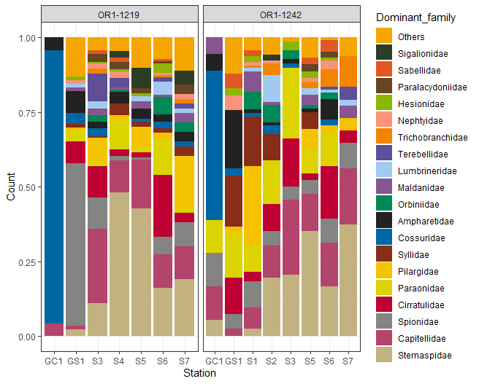
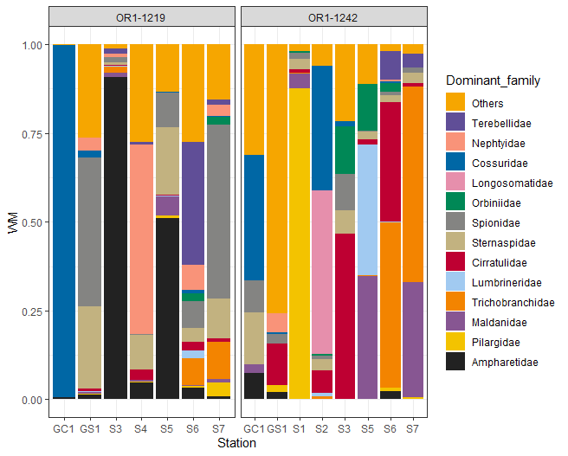
Notes:
Only include complete and head intact specimen since the ecological question is about how many recognizable individuals.
If keeping all the specimen disregarding their condition, the ecological question will essentially become how many specimens can be attributed to certain taxonomic groups.

Slide 8
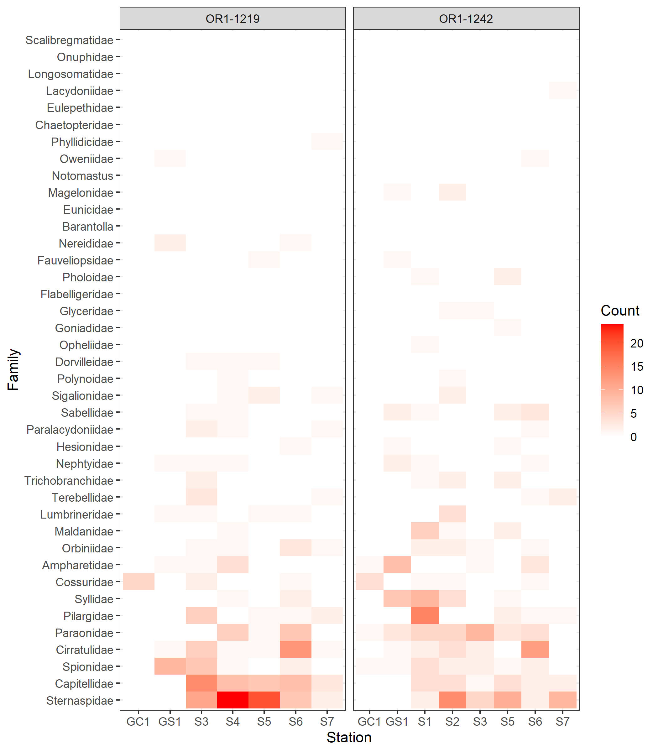
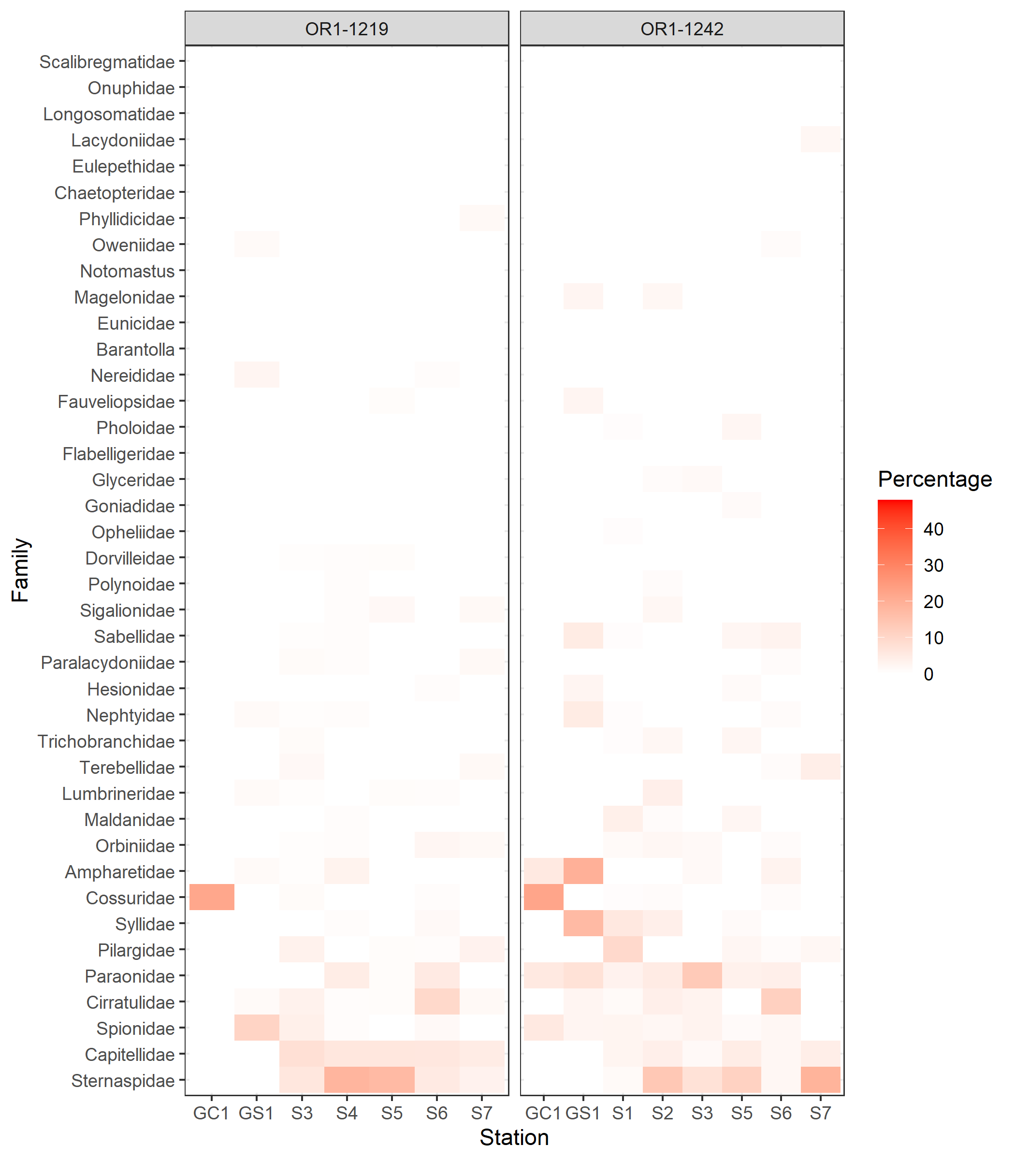

Slide 9
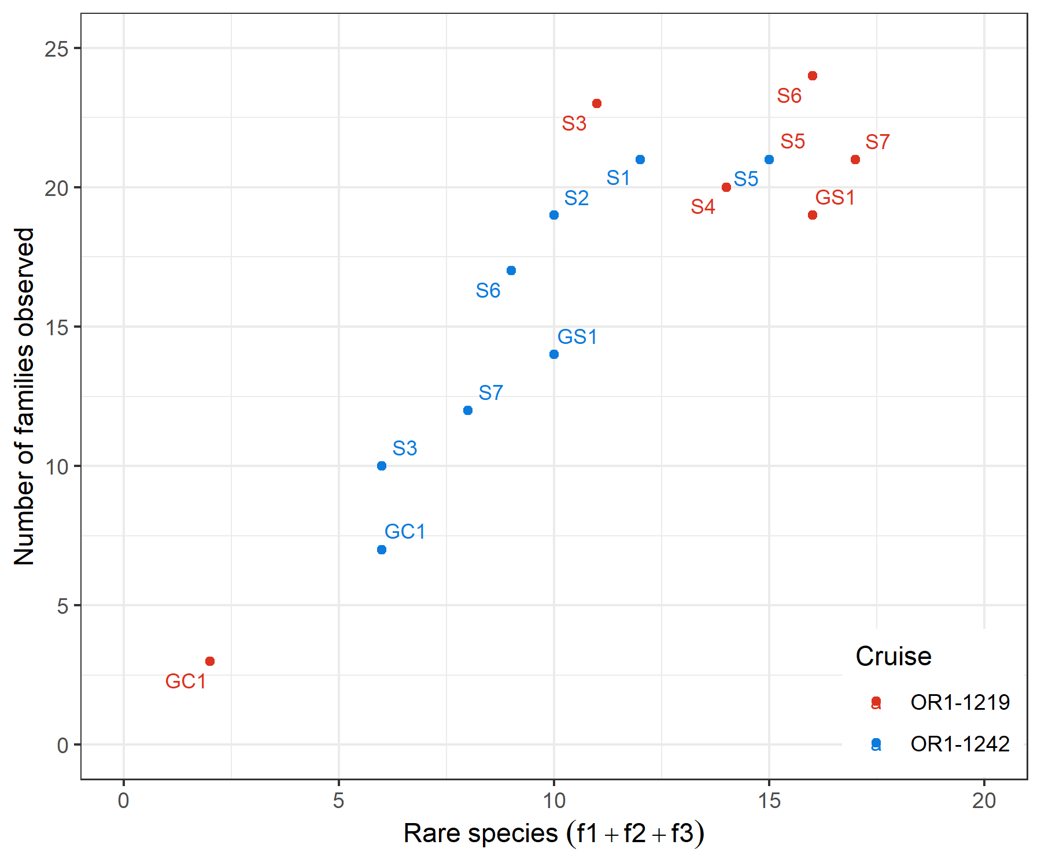
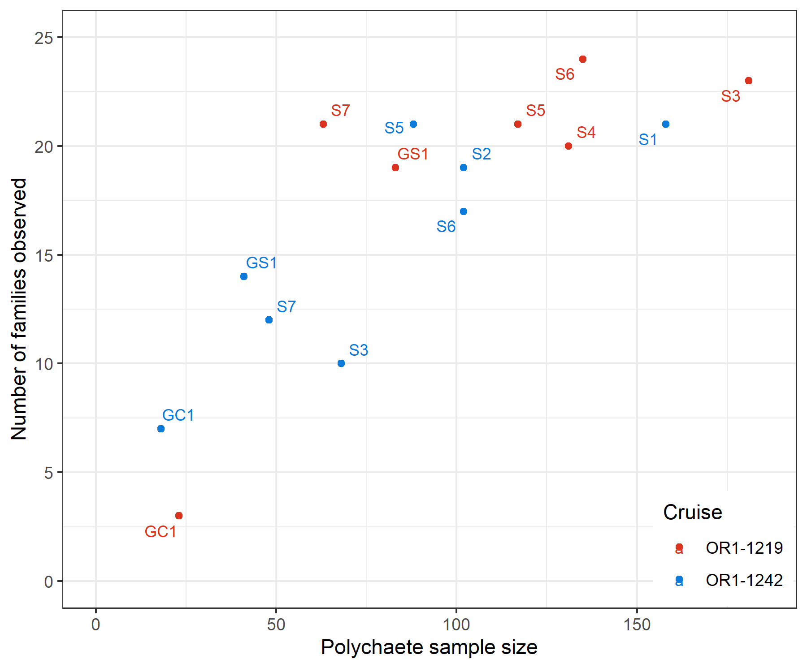
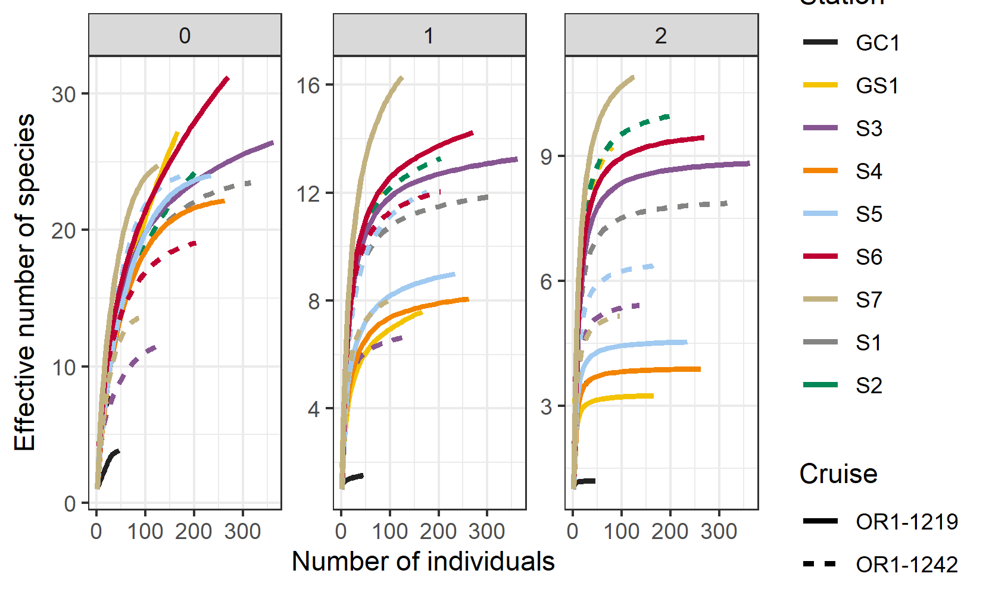
iNEXT(datatype = “abundance”)

